Slide 1
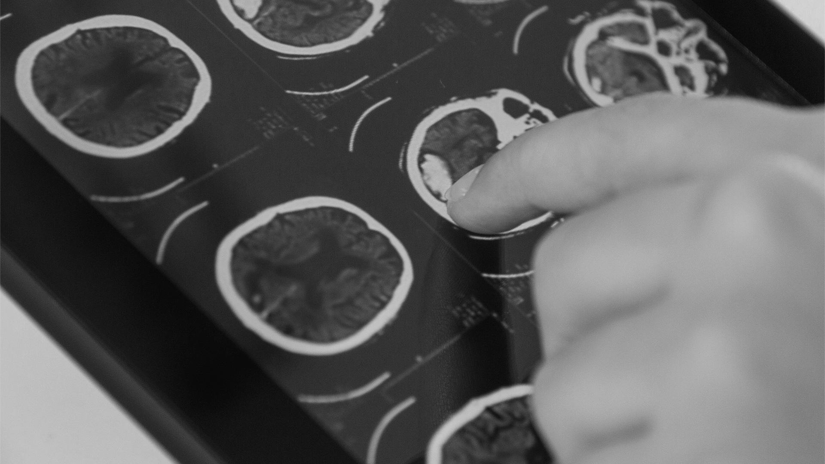
HEART DISEASE
PREDICTION
Presented by : Hesham Doom &
Abdullah Alsubaie

Slide 2
INTRODUCTION
We received a request from the health authorities to create a system that classifies
the diseased case from the regular cases, and the project will lay the basic building
block for the classification process for a database on a broad segment of society.

Slide 3

OBJECTIVES
01.
Make a qualitative classification of the referral received on
the model to know the affected case from the normal cases.
02.
Provide a balanced analysis of the number of people tested and by the system.
03.
Ensure the correctness, effectiveness, and accuracy of the model after running.

Slide 4
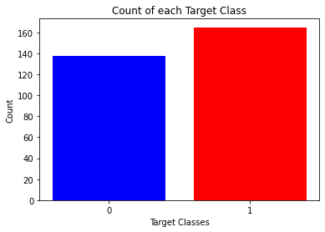
VISUALIZATION
It's always a good practice to work with a dataset where the target classes are of approximately equal size.

Slide 5
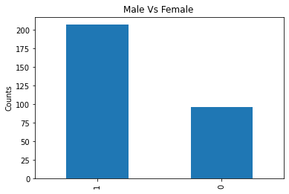
according to the figure above
Male gender is the most aboard the ship

Slide 6
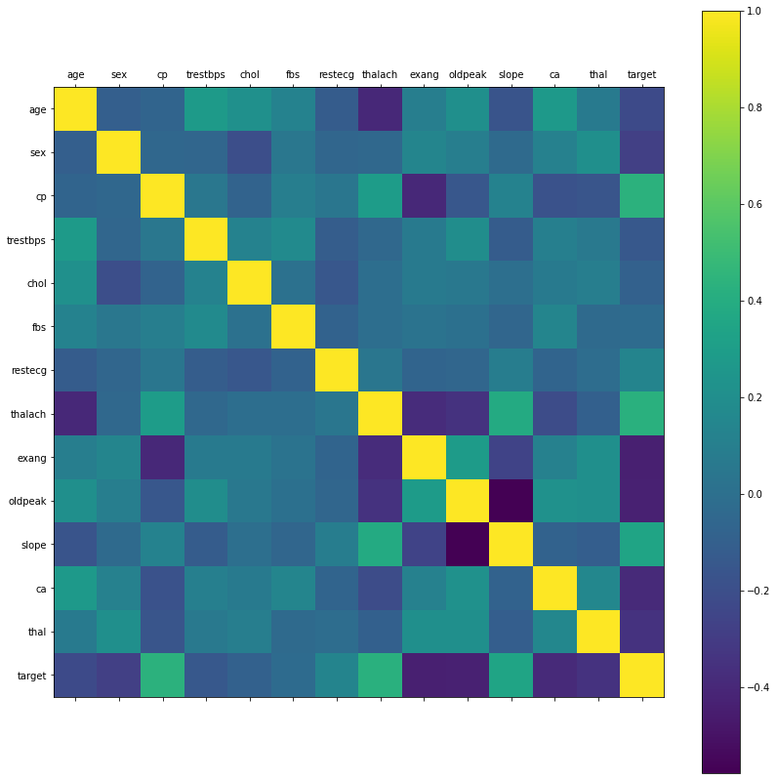
Taking a look at the correlation matrix above, it's easy to see that a few features have negative correlation with the target value while some have positive.

Slide 7

Data Processing
After exploring the dataset, I observed that I need to convert some categorical variables into dummy variables and scale all the values before training the Machine Learning models

Slide 8
MACHINE LEARNING
01
02
03
Logistic Regression
Decision Tree
K-Nearest Neighbors
Test gives 84 % Score
Test gives 85 % Score
Test gives 87 % Score

Slide 9
CONCLUSION
In this project, I used Machine Learning to predict whether a person is suffering from a heart disease. After importing the data, I analysed it using plots. Then, I did generated dummy variables for categorical features and scaled other features. I then applied four Machine Learning algorithms, Logistic Regression, Decision Tree Classifier and K Neighbors Classifier. I varied parameters across each model to improve their scores. In the end, K Neighbors Classifier achieved the highest score of 87% with 8 nearest neighbors.

Slide 10
Classification of the disease- Project
THANK
YOU

